Slide 1
Shortest Path Problem

Slide 2
Definitions
In graph theory, the shortest path problem is the problem of finding a path between two vertices (or nodes) in a graph such that the sum of the weights of its constituent edges is minimized

Slide 3
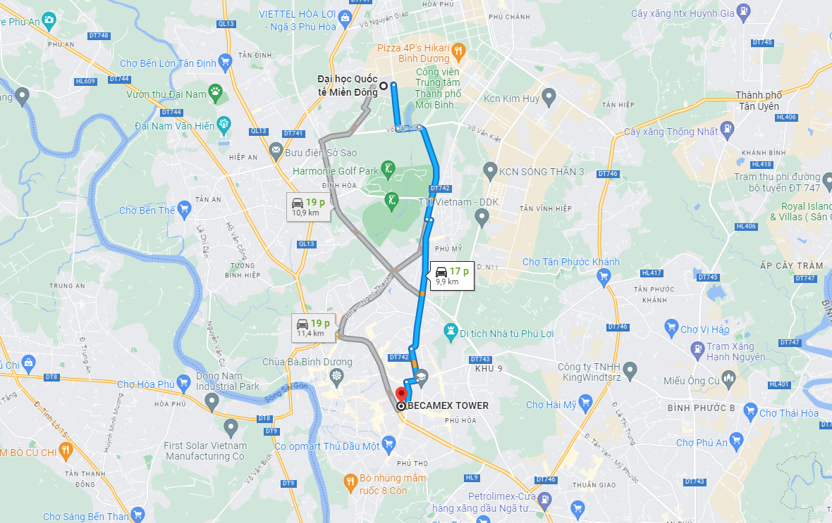
Applications
Circuit design
Routing
Google Map
Travelling salesman - TSP

Slide 4
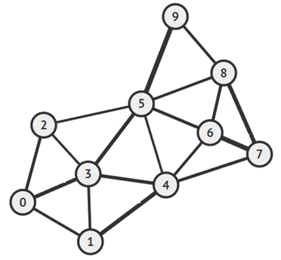
Examples – Unweighted graph
Find the shortest path from 0 to other vertices.

Slide 5
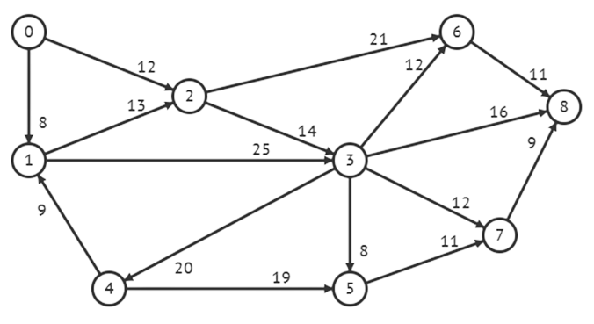
Examples
Given the graph below, find the shortest path from 0 to 8.

Slide 6
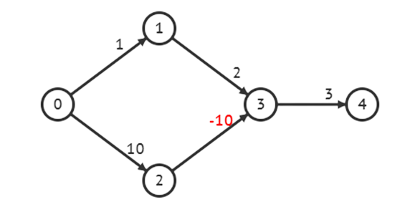
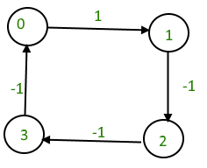
Negative Weight
Negative edges may be end up in a negative cycle whereby each pass through the cycle decreases the total weight (cost). A shortest length would be undefined for such a graph
Some algorithms can works with graph including negative edges while the others can’t

Slide 7
Variants of the shortest path problems
Single source
  To single destination
  To multiple vertices
Between every pair of vertices

Slide 8
Dijkstra algorithm
Works when all of the weights are positive.
Provides the shortest paths from a source to all other vertices in the graph.
  Can be terminated early once the shortest path to t is found if desired.

Slide 9
Dijkstra algorithm - Comments
If the shortest path from t to s contains the node v, then:
  It will only contain v once.
  The path from s to v must be the shortest path to v from s.
  The path from v to t must be the shortest path to t from v.
If the shortest paths to all other vertices that are incident to the target vertex are determined, it is easy to compute the shortest path.

Slide 10
Dijkstra’s Algorithm
Initially, we will start with the path of length 0
  The trivial path from vertex 0 to itself
If the starting vertex has any adjacent edges, then there will be one vertex that has the shortest distance from the starting vertex. This is the shortest reachable vertex of the graph.
Then try to extend any existing paths to new vertices.

Slide 11
Dijkstra’s Algorithm
Initialization
Set the current distance to the initial vertex (starting vertex) as 0
For all other vertices, set the current distance to ∞
All vertices are initially marked as unvisited
Set the previous vertex for all vertices to null

Slide 12
Dijkstra’s Algorithm
Iteration:
  Find an unvisited vertex u which has the shortest distance to it and mark it as visited
  If all vertices are visited, stop the iteration
  If the target vertex (if desired) is visited, stop the iteration
  For each unvisited vertex v which is adjacent to u:
    add the distance to u to the weight of the connecting edge (u, v)
    if this is less than the current distance to that vertex, update the distance and set the parent vertex of the adjacent vertex to be the current vertex
  If all remaining unvisited vertices have distance ∞, then no path from the starting vertex to them, stop the iteration

Slide 13
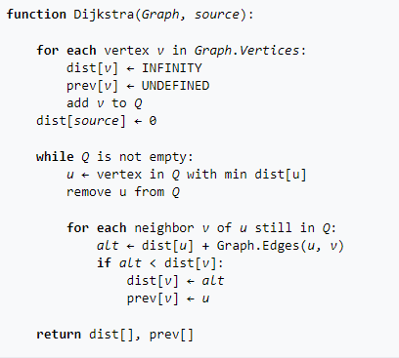
Dijkstra’s Algorithm

Slide 14
Dijkstra’s Algorithm
How to determine the shortest path (not shortest path length) from u to v?

Slide 15
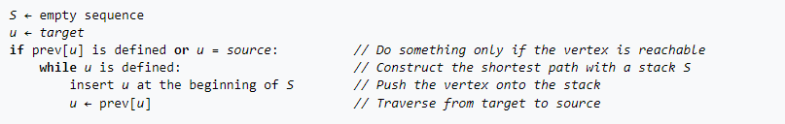
Dijkstra’s Algorithm
How to determine the shortest path (not shortest path length) from u to v?

Slide 16
Dijkstra’s Algorithm - Running time
Initiazation: O(|V|)
Iteration: The complexity bound depends mainly on the data structure used to represent the set unvisited vertices Q
The simplest version of Dijkstra's algorithm stores the vertex set Q as a linked list or array, and edges as an adjacency list or matrix, then the running time is O(|V|² + |E|).
For sparse graphs, Dijkstra's algorithm can be implemented more efficiently by storing the graph in the form of adjacency lists and using data structure such as self-balancing binary search tree, binary heap, pairing heap, or Fibonacci heap as a priority queue to implement extracting minimum efficiently, the running time of Dijkstra's algorithm can be reduced to O((|E|+|V|)log|V|)

Slide 17
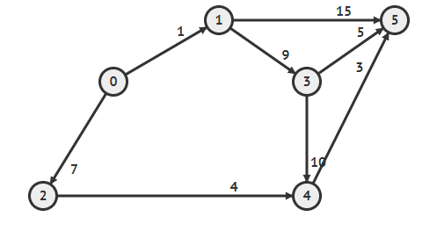
Examples
Consider the following graph and compute the shortest path from 0 to other vertices.

Slide 18
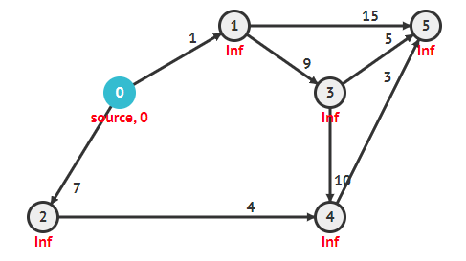
Examples
Initialization
Vertex | Visited | Distance | Previous
0 | False | 0 | N/A
1 | False | ∞ | N/A
2 | False | ∞ | N/A
3 | False | ∞ | N/A
4 | False | ∞ | N/A
5 | False | ∞ | N/A

Slide 19
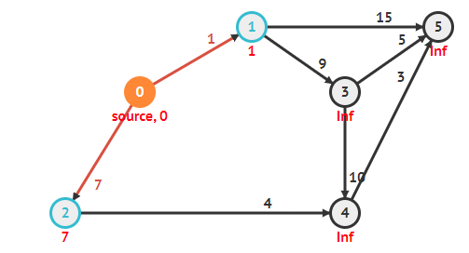
Examples
0 is the unvisited vertex with minimum distance. Update the distance to other adjacent vertices of vertex 0
Vertex | Visited | Distance | Previous
0 | True | 0 | N/A
1 | False | ∞,1 | 0
2 | False | ∞,7 | 0
3 | False | ∞ | N/A
4 | False | ∞ | N/A
5 | False | ∞ | N/A

Slide 20
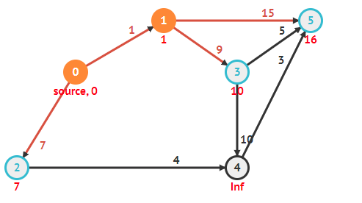
Examples
1 is the unvisited vertex with minimum distance. Update the distance to other adjacent vertices of vertex 1
Vertex | Visited | Distance | Previous
0 | True | 0 | N/A
1 | True | ∞,1 | 0
2 | False | ∞,7 | 0
3 | False | ∞,10 | 1
4 | False | ∞ | N/A
5 | False | ∞,16 | 1

Slide 21
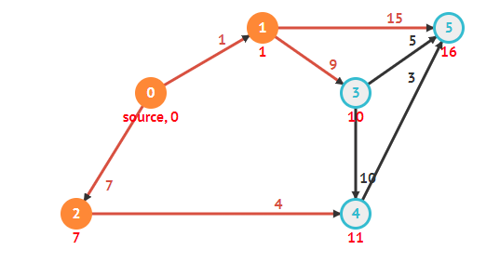
Examples
2 is the unvisited vertex with minimum distance. Update the distance to other adjacent vertices of vertex 2
Vertex | Visited | Distance | Previous
0 | True | 0 | N/A
1 | True | ∞,1 | 0
2 | True | ∞,7 | 0
3 | False | ∞,10 | 1
4 | False | ∞,11 | 2
5 | False | ∞,16 | 1

Slide 22
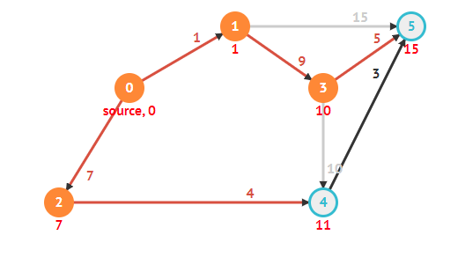
Examples
3 is the unvisited vertex with minimum distance. Update the distance to other adjacent vertices of vertex 3
Vertex | Visited | Distance | Previous
0 | True | 0 | N/A
1 | True | ∞,1 | 0
2 | True | ∞,7 | 0
3 | True | ∞,10 | 1
4 | False | ∞,11 | 2
5 | False | ∞,16, 15 | 1, 3

Slide 23
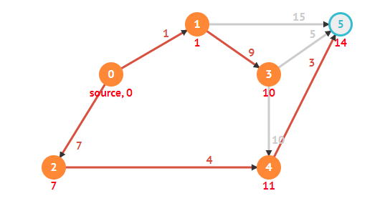
Examples
4 is the unvisited vertex with minimum distance. Update the distance to other adjacent vertices of vertex 4
Vertex | Visited | Distance | Previous
0 | True | 0 | N/A
1 | True | ∞,1 | 0
2 | True | ∞,7 | 0
3 | True | ∞,10 | 1
4 | True | ∞,11 | 2
5 | False | ∞,16, 15, 14 | 1, 3, 4

Slide 24
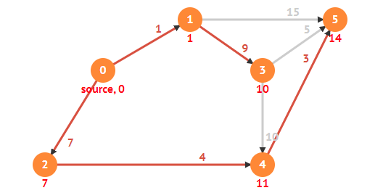
Examples
5 is the unvisited vertex with minimum distance. Update the distance to other adjacent vertices of vertex 5

Slide 25
Implementation

Slide 26
Bellman–Ford algorithm

Slide 27
Bellman–Ford algorithm
Provides the shortest paths from a source to all other vertices in the graph.
If a negative-weight cycle is reachable from the source 𝑠
  For every vertex v that is reachable from that cycle (including vertices on the cycle), the shortest path does not exist.
  Vertices not reachable from that cycle can still have well-defined shortest paths.
Bellman-Ford algorithm can detect negative cycles and report their existence.

Slide 28
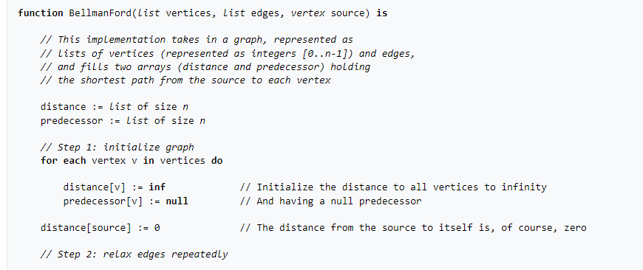
Bellman–Ford algorithm

Slide 29
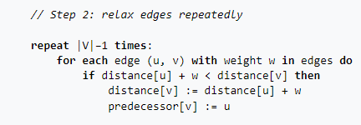
Bellman–Ford algorithm

Slide 30
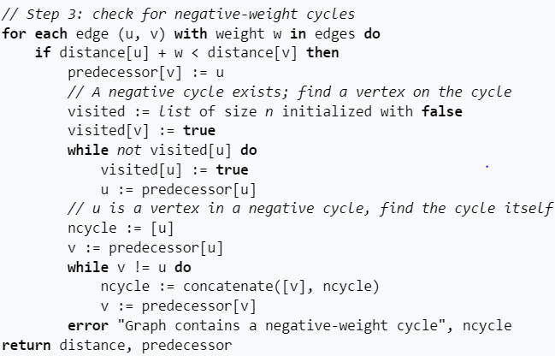
Check for negative cycle

Slide 31
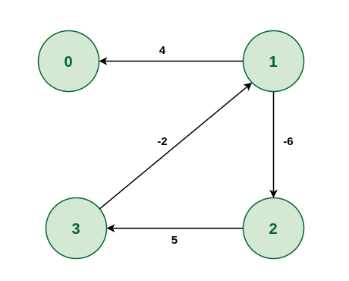
Examples
Find the shortest path from 1 to other vertices.

Slide 32
Examples
Iterate | 0 | 1 | 2 | 3
0 | (∞, None) | (0, None) | (∞, None) | (∞, None)
1 | (4, 1) | (0, None) | (-6, 1) | (-1, 2)
2 | (4, 1) | (-3, 3) | (-6, 1) | (-1, 2)
3 | (1, 1) | (-4, 3) | (-6, 1) | (-1, 2)

Slide 33
Examples
Check if a negative circuit exists:
  Because distance (0) > distance (1) + w₁₀ → a negative cycle exists.
  Set the predecessor of vertex 0 to 1.
  Starting from vertex 0, find a vertex that belongs to the negative cycle → vertex 1
  Find the negative circuit: 1 ← 3 ← 2 ← 1
Iterate | 0 | 1 | 2 | 3
0 | (∞, None) | (0, None) | (∞, None) | (∞, None)
1 | (4, 1) | (0, None) | (-6, 1) | (-1, 2)
2 | (4, 1) | (-3, 3) | (-6, 1) | (-1, 2)
3 | (1, 1) | (-4, 3) | (-6, 1) | (-1, 2)

Slide 34
Correctness
In a graph with ∣𝑉∣ vertices, the shortest path from s to any vertex v will never contain more than ∣𝑉∣−1 edges (since a longer path would repeat vertices and form a cycle).
The algorithm relaxes all edges ∣𝑉∣−1 times, which guarantees that all shortest paths without cycles are considered.

Slide 35
Correctness
After k relaxations, the algorithm finds the shortest paths using at most k
Base case (k = 0):
The distance from the source s to itself is 0, and ∞ to all others. No edges are used ⇒ correct.
Inductive step:
Assume after k−1 iterations, the shortest paths using up to k−1 edges are correctly computed.
During the k-th iteration, if a shorter path using k edges exists, the relaxation will update the distance accordingly.
⇒ After k iterations, the algorithm has computed the shortest paths that use at most k edges.
Therefore, after ∣V∣−1 iterations, all shortest paths without cycles are guaranteed to be found.

Slide 36
Correctness
If an edge can still be relaxed after ∣𝑉∣−1 iterations → a negative-weight cycle exists
If for some edge (𝑢,𝑣), distance[u] + w < distance[v] still holds after ∣𝑉∣−1 iterations, it means that a better path has been found, violating the assumption that shortest paths are already computed (maximum |V| - 1 edges). This implies that the path improvement is due to a cycle, since all simple paths must already have been considered.
And if the improvement continues, the cycle must be negative in total weight (since it reduces the cost).The algorithm detects this by tracing back through the predecessor array to identify the cycle.

Slide 37
Bellman–Ford algorithm
In a undirected graph , If a negative-weight cycle is reachable from the source, then the shortest paths computed in Step 2 of the Bellman-Ford algorithm may be invalid.
However, in a directed graph, if there is no path from the source to the destination that passes through any vertex in a negative cycle, then the shortest path to that destination is still correct.
How to Identify Safe Destination Vertices?

Slide 38
Bellman–Ford algorithm
Detect Negative Cycle Nodes: See step 3
Propagate Reachability:
From those cycle nodes, use BFS/DFS to mark all affected vertices (reachable from the cycles)
Safe Destinations = V \ Affected:
All other vertices are safe: their shortest paths remain valid.

Slide 39
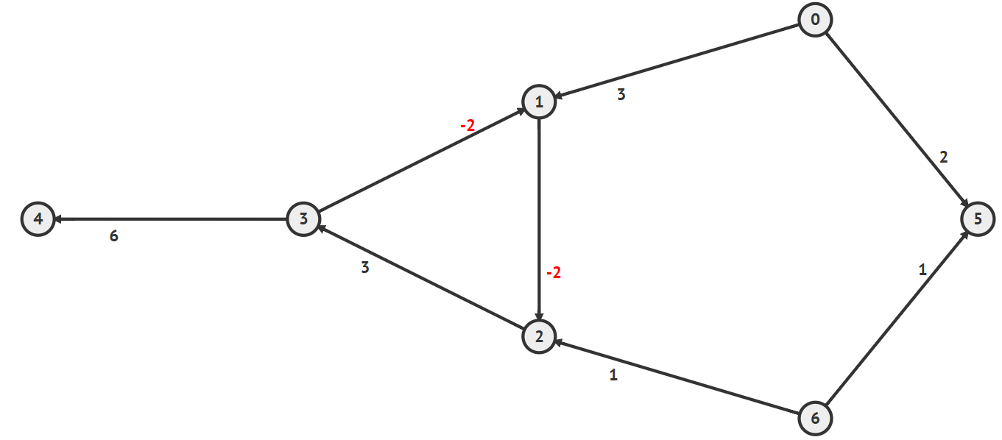
Examples

Slide 40
Floyd–Warshall algorithm

Slide 41
Floyd–Warshall algorithm
Provides the shortest paths between all pairs of vertices in a directed graph
Can detect negative cycle

Slide 42
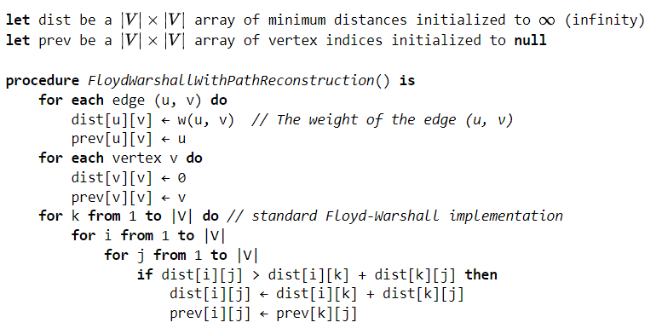
Floyd–Warshall algorithm

Slide 43
Correctness
The Floyd–Warshall algorithm iteratively revises path lengths between all pairs of vertices
  At iteration k, we compute shortest paths whose intermediate vertices (if any) are all in the set {1,…,k}.
  Proof:
  Invariant. Let d^{(k)}[i][j] be the shortest distance from i to j whose intermediate vertices (if any) lie in {1,…,k}.
  Initialization (k=0): no intermediates → direct edges (and 0 on the diagonal).
  Inductive step. Assume the invariant holds for k−1. For any i, j a shortest path that uses only intermediates in {1,…,either:
  In the iteration k, there are two cases:
  (1) the shortest path does not go through k: d^{(k-1)}[i][j] or
  (2) it does go through k and splits at k into two optimal subpaths: dist^{(k)}[i][j] ≥ dist^{(k - 1)} [i][k] + dist ^{(k-1)} [k][j]
  Conclusion. After k=nk=nk=n, all vertices are allowed as intermediates, so d(n)d^{(n)}d(n) gives all-pairs shortest-path distances.
.

Slide 44
Correctness (2)
  Negative Cycle Detection in Floyd–Warshall
Initially, the length of the path (u, u) is zero;
A cycle (u, a, b, c, … u) can only improve upon this if it has length less than zero, i.e. denotes a negative cycle;
Thus, after the algorithm, d(u, u) will be negative if there exists a negative cycle from u back to u .

Slide 45
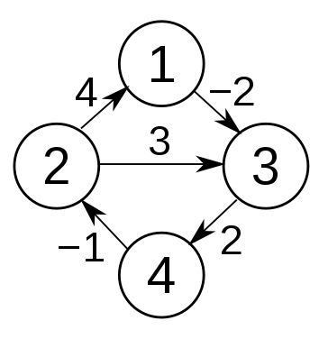
Floyd–Warshall algorithm

Slide 46
Floyd–Warshall algorithm
Initilization: k = 0
 | 1 | 2 | 3 | 4
1 | (0, 1) | (∞, -) | (-2, 1) | (∞, -)
2 | (4, 2) | (0, 2) | (3, 2) | (∞, -)
3 | (∞, -) | (∞, -) | (0, 3) | (2, 3)
4 | (∞, -) | (-1, 4) | (∞, -) | (0, 4)

Slide 47
Floyd–Warshall algorithm
k = 1: d[2][3] > d[2][1] + d[1][3]
 | 1 | 2 | 3 | 4
1 | (0, 1) | (∞, -) | (-2, 1) | (∞, -)
2 | (4, 2) | (0, 2) | (3, 2) (2, 1) | (∞, -)
3 | (∞, -) | (∞, -) | (0, 3) | (2, 3)
4 | (∞, -) | (-1, 4) | (∞, -) | (0, 4)

Slide 48
Floyd–Warshall algorithm
k = 2: d[4][1] > d[4][2] + d[2][1]
 | 1 | 2 | 3 | 4
1 | (0, 1) | (∞, -) | (-2, 1) | (∞, -)
2 | (4, 2) | (0, 2) | (3, 2) (2, 1) | (∞, -)
3 | (∞, -) | (∞, -) | (0, 3) | (2, 3)
4 | (∞, -) (3, 2) | (-1, 4) | (∞, -) | (0, 4)

Slide 49
Floyd–Warshall algorithm
k = 2: d[4][3] > d[4][2] + d[2][3]
 | 1 | 2 | 3 | 4
1 | (0, 1) | (∞, -) | (-2, 1) | (∞, -)
2 | (4, 2) | (0, 2) | (3, 2) (2, 1) | (∞, -)
3 | (∞, -) | (∞, -) | (0, 3) | (2, 3)
4 | (∞, -) (3, 2) | (-1, 4) | (∞, -) (1, 1) | (0, 4)

Slide 50
Floyd–Warshall algorithm
k = 3: d[1][4] > d[1][3] + d[3][4]
 | 1 | 2 | 3 | 4
1 | (0, 1) | (∞, -) | (-2, 1) | (∞, -) (0, 3)
2 | (4, 2) | (0, 2) | (3, 2) (2, 1) | (∞, -)
3 | (∞, -) | (∞, -) | (0, 3) | (2, 3)
4 | (∞, -) (3, 2) | (-1, 4) | (∞, -) (1, 1) | (0, 4)

Slide 51
Floyd–Warshall algorithm
k = 3: d[2][4] > d[2][3] + d[3][4]
 | 1 | 2 | 3 | 4
1 | (0, 1) | (∞, -) | (-2, 1) | (∞, -) (0, 3)
2 | (4, 2) | (0, 2) | (3, 2) (2, 1) | (∞, -) (4, 3)
3 | (∞, -) | (∞, -) | (0, 3) | (2, 3)
4 | (∞, -) (3, 2) | (-1, 4) | (∞, -) (1, 1) | (0, 4)

Slide 52
Floyd–Warshall algorithm
k = 4: d[3][1] > d[3][4] + d[4][1]
 | 1 | 2 | 3 | 4
1 | (0, 1) | (∞, -) | (-2, 1) | (∞, -) (0, 3)
2 | (4, 2) | (0, 2) | (3, 2) (2, 1) | (∞, -) (4, 3)
3 | (∞, -) (5, 2) | (∞, -) | (0, 3) | (2, 3)
4 | (∞, -) (3, 2) | (-1, 4) | (∞, -) (1, 1) | (0, 4)

Slide 53
Floyd–Warshall algorithm
k = 4: d[3][2] > d[3][4] + d[4][2]
 | 1 | 2 | 3 | 4
1 | (0, 1) | (∞, -) | (-2, 1) | (∞, -) (0, 3)
2 | (4, 2) | (0, 2) | (3, 2) (2, 1) | (∞, -) (4, 3)
3 | (∞, -) (5, 2) | (∞, -) (1, 4) | (0, 3) | (2, 3)
4 | (∞, -) (3, 2) | (-1, 4) | (∞, -) (1, 1) | (0, 4)

Slide 54
Floyd–Warshall algorithm
k = 4: d[1][2] > d[1][4] + d[4][2]
 | 1 | 2 | 3 | 4
1 | (0, 1) | (∞, -) (-1, 4) | (-2, 1) | (∞, -) (0, 3)
2 | (4, 2) | (0, 2) | (3, 2) (2, 1) | (∞, -) (4, 3)
3 | (∞, -) (5, 2) | (∞, -) (1, 4) | (0, 3) | (2, 3)
4 | (∞, -) (3, 2) | (-1, 4) | (∞, -) (1, 1) | (0, 4)

